Slide 1
JPA : Java Persistence API
Notes:
To create the footer use the insert tab and then select header and footer this will enable a footer to be added to each slide
Partner / customer logo is optional and can be removed for internal slides

Slide 2
Topics to be covered
Introduction to java persistence
The Java Persistence API
Entities
Entity Mappings (Relationships)
HAS-A Aggregation
IS-A Inheritance
Entity Manager the Persistent Context & Life cycle of Entity
Types of EntityManager
JPA Query Language

Slide 3
Introduction to java persistence API
What is JPA?
Java Persistence API is a collection of classes and methods to persistently store the vast amounts of data into a database which is provided by the Oracle Corporation
Why to use JPA?
Eliminates all of the 'hand' mapping in Java from a SQL ResultSet to a Java POJO greatly reducing the amount of mapping work
Reduce object ←→ relation (table) mismatch
Leverages large persistence library to avoid developing solutions to problems that others have already solved.
Supports both Java EE and Java SE
JPA provider can easily be switched .
Where to use JPA?
JPA can be used in Java SE 5 application (onwards) without a container!!!! And in Java EE applications with containers

Slide 4
Introduction to java persistence API
JPA History :
Earlier versions of EJB, defined persistence layer combined with business logic layer using javax.ejb.EntityBean Interface
While introducing EJB 3.0, the persistence layer was separated and specified as JPA 1.0 (Java Persistence API). The specifications of this API were released along with the specifications of JAVA EE5 on May 11, 2006 using JSR 220.
JPA 2.0 was released with the specifications of JAVA EE6 on December 10, 2009 as a part of Java Community Process JSR 317.
JPA 2.1 was released with the specification of JAVA EE7 on April 22, 2013 using JSR 338
JPA Providers
JPA is an open source API, therefore various enterprise vendors such as Oracle, Redhat, Eclipse, etc. provide new products by adding the JPA persistence flavor in them. Some of these products include: Hibernate, Eclipselink, Toplink, Spring Data JPA, etc.

Slide 5

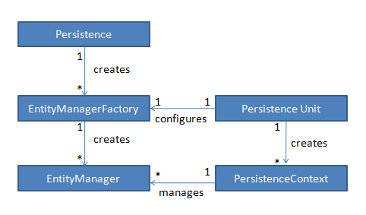
Introduction to java persistence API
Java -JPA-Database
Java Application
Database driver (.jar)
1
uses
1
Database
1
*
entities
*
Query

Slide 6
Introduction to java persistence API
Persistence: The javax.persistence.Persistence class contains static helper methods to obtain EntityManagerFactory instances in a vendor-neutral fashion.
EntityManagerFactory: The javax.persistence.EntityManagerFactory class is a factory for EntityManager s.
EntityManager: The javax.persistence.EntityManager is the primary JPA interface used by applications. Each EntityManager manages a set of persistent objects, and has APIs to insert new objects and delete existing ones. EntityManagers also act as factories for Query instances.
Entity : Entites are persistent objects that represent database records.
Persistence Units Persistence unit contains configuration to connect with database. Persistence units are defined by the persistence.xml configuration file
Persistence Context: A persistence context handles a set of entities which hold data to be persisted/deleted in/from some persistence store (e.g. a database). In particular, the context is aware of the different states an entity can have (e.g. managed,removed)
Query : The javax.persistence.Query interface is implemented by each JPA vendor to find persistent objects that meet certain criteria. JPA standardizes support for queries using both the Java Persistence Query Language (JPQL) and the Structured Query Language (SQL). You obtain Query instances from an EntityManager.

Slide 7
ENTITY
An entity is a plain old java object (POJO) The Class represents a table in a relational database. instances of this entity (POJO) correspond to rows in database table.
Requirements:
annotated with the javax.persistence.Entity annotation
public or protected no-argument constructor
the class must NOT be declared final
no methods or persistent instance variables must be declared final
May be Serializable, but not required Only needed if passed by value (in a remote call)
Persistent instance variables must be declared private, protected.

Slide 8
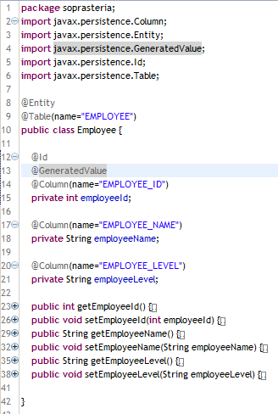
Entity
The persistent state of an entity can be accessed:
through JavaBeans-style properties (getters/setters)
Supported types:
primitive types, String, other serializable types, enumerated types
other entities and/or collections of entities
embeddable classes
All fields not annotated with @Transient or not marked as Java transient will be persisted to the data store!

Slide 9
PERSISTENT IDENTIFIER : PRIMARY KEY
Each entity must have a unique object identifier (persistent identifier) Identifier (id) in entity = primary key in database
Uniquely identifies entity in memory and in DB
Persistent identity types:
Simple id – single field/property: @Id int id;
Compound id – multiple fields/properties @Id int id; @Id String name;
Embedded id – single field of PK class type @EmbeddedId EmployeePK id;
Identifiers can be generated in the database by specifying @GeneratedValue on the identifier
Four pre-defined generation strategies:
AUTO, IDENTITY, SEQUENCE, TABLE
Generators may pre-exist or be generated
Specifying strategy of AUTO indicates that the provider will choose a strategy
@Id
@GeneratedValue(strategy=AUTO)
private int id;

Slide 10
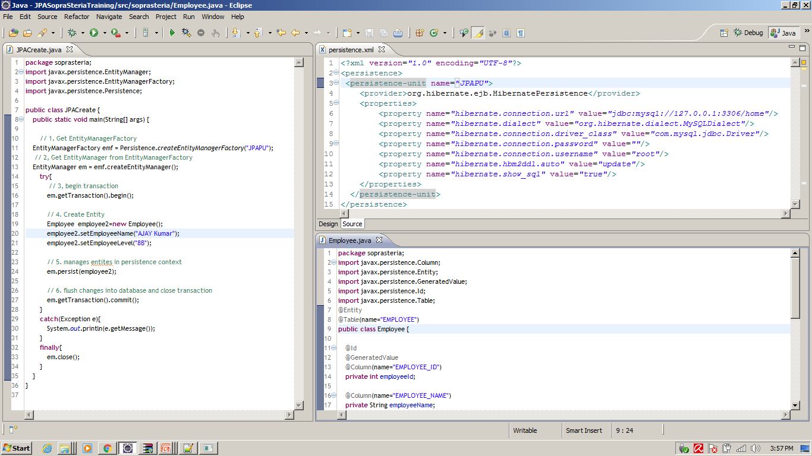
example: insert record

Slide 11
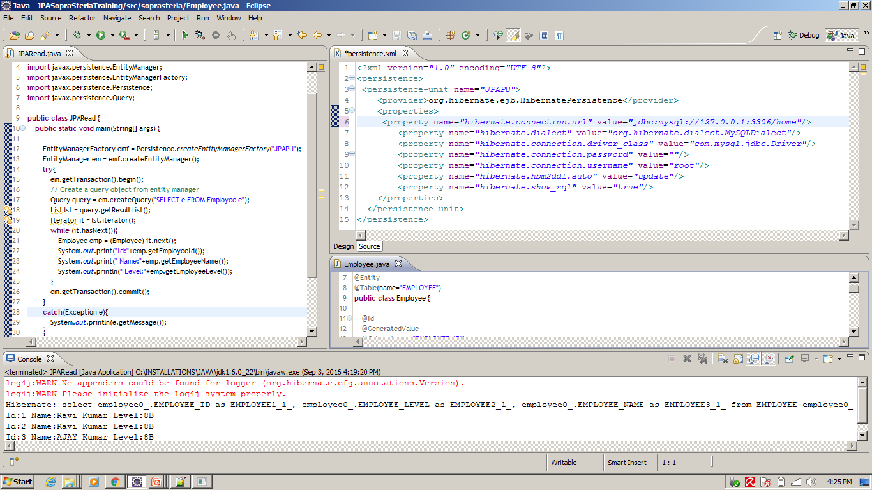
example: select records

Slide 12
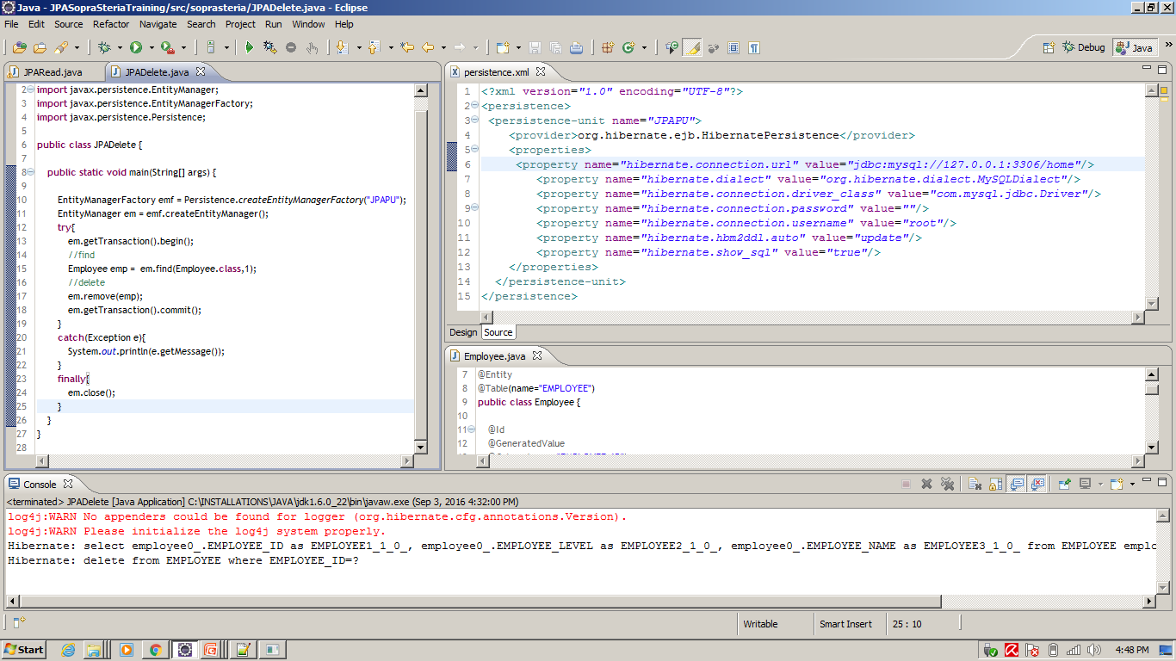
example: find and delete records

Slide 13
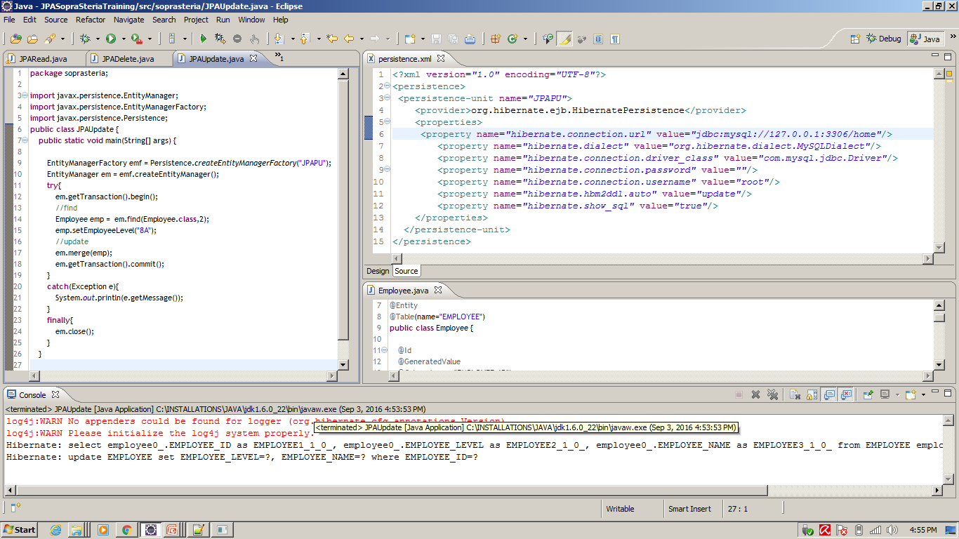
example: find and UPDATE records

Slide 14
Entity : Relationship between entities
HAS –A Mapping between entities
There are four types of HAS –A mappings
@OneToOne
@OneToMany
@ManyToOne
@ManyToMany
The direction of a relationship can be:
bidirectional – owning side and inverse side
unidirectional – owning side only
JPA supports cascading of operation between related entities:
CascadeType : ALL, PERSIST, MERGE, REMOVE, REFRESH
You can declare performance strategy to use with fetching related rows
FetchType : LAZY, EAGER (Lazy means don't load row until the property is retrieved)
Let us see detailed example of the of each of the mappings on next slides

Slide 15
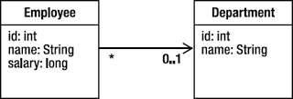
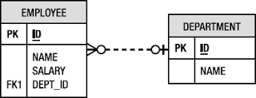
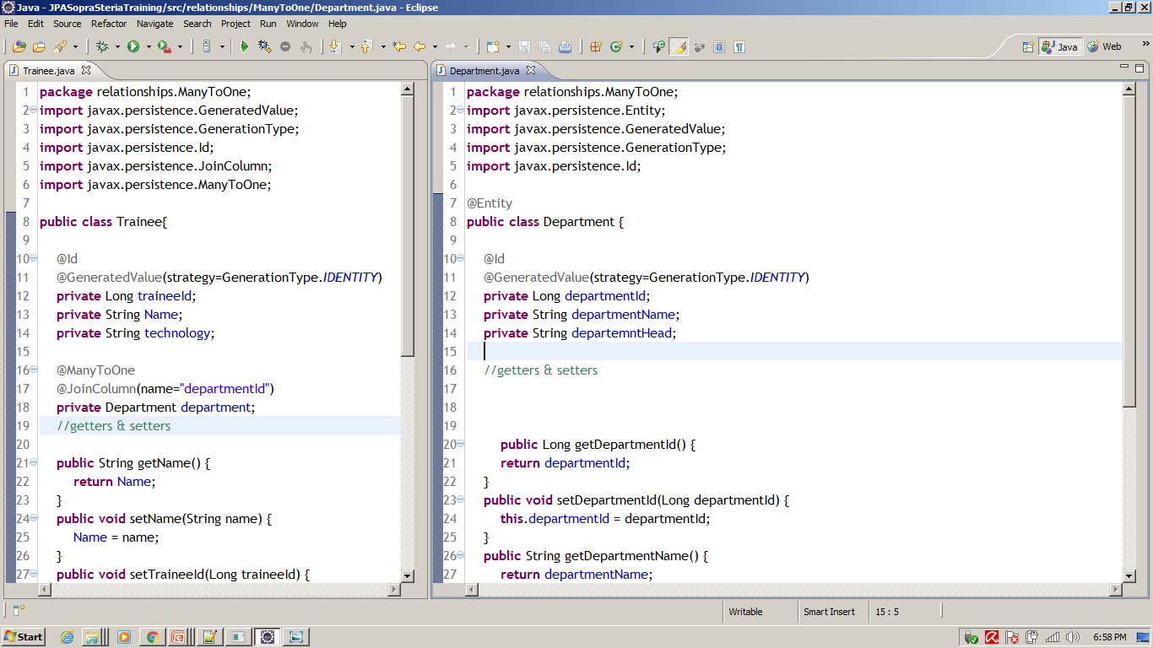
Entity : Relationship between entities : HAS-A
@ManyToOne Unidirectional Relationship

Slide 16
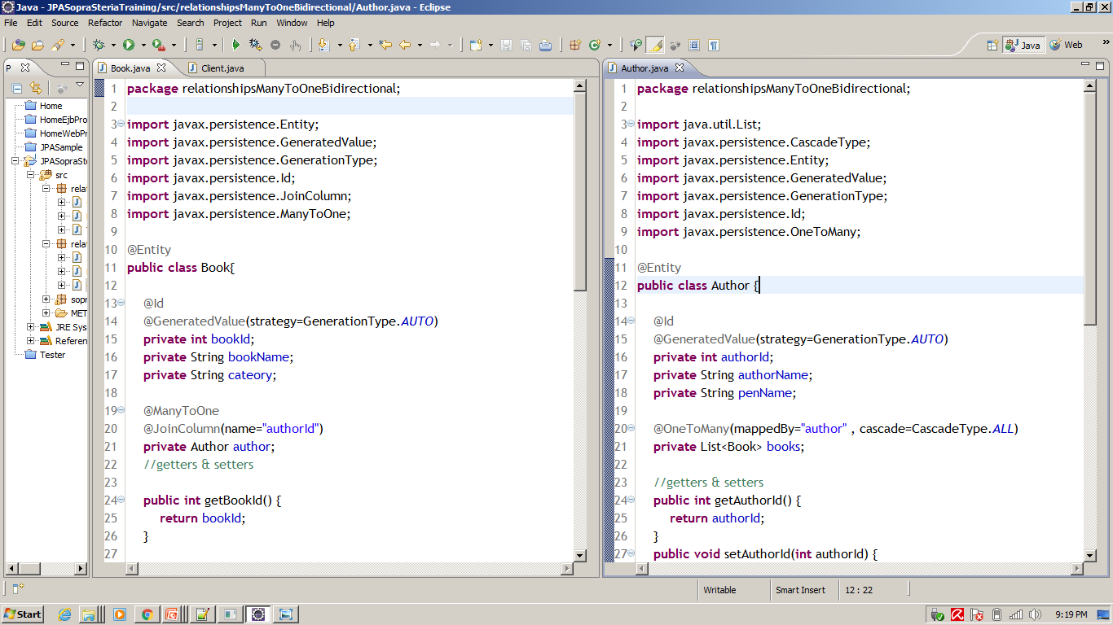
Entity : Relationship between entities : HAS-A
@ManyToOne ←→ @OneToMany bidirectional Relationship

Slide 17
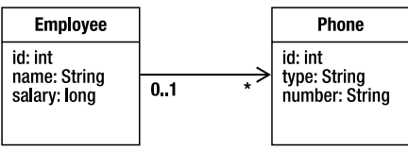
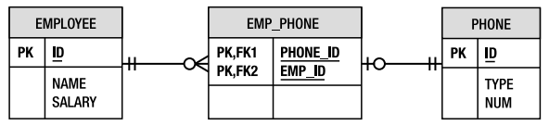
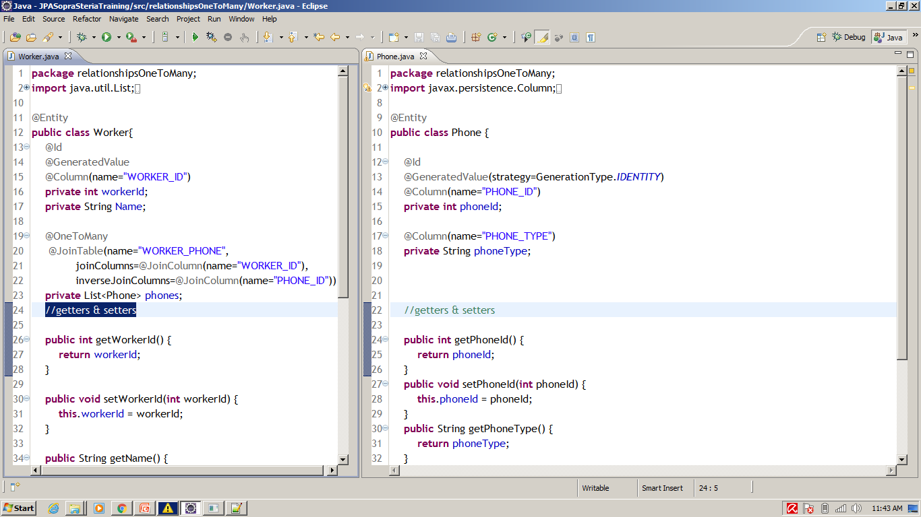
Entity : Relationship between entities : HAS-A
@OneToMany Unidirectional Relationship

Slide 18
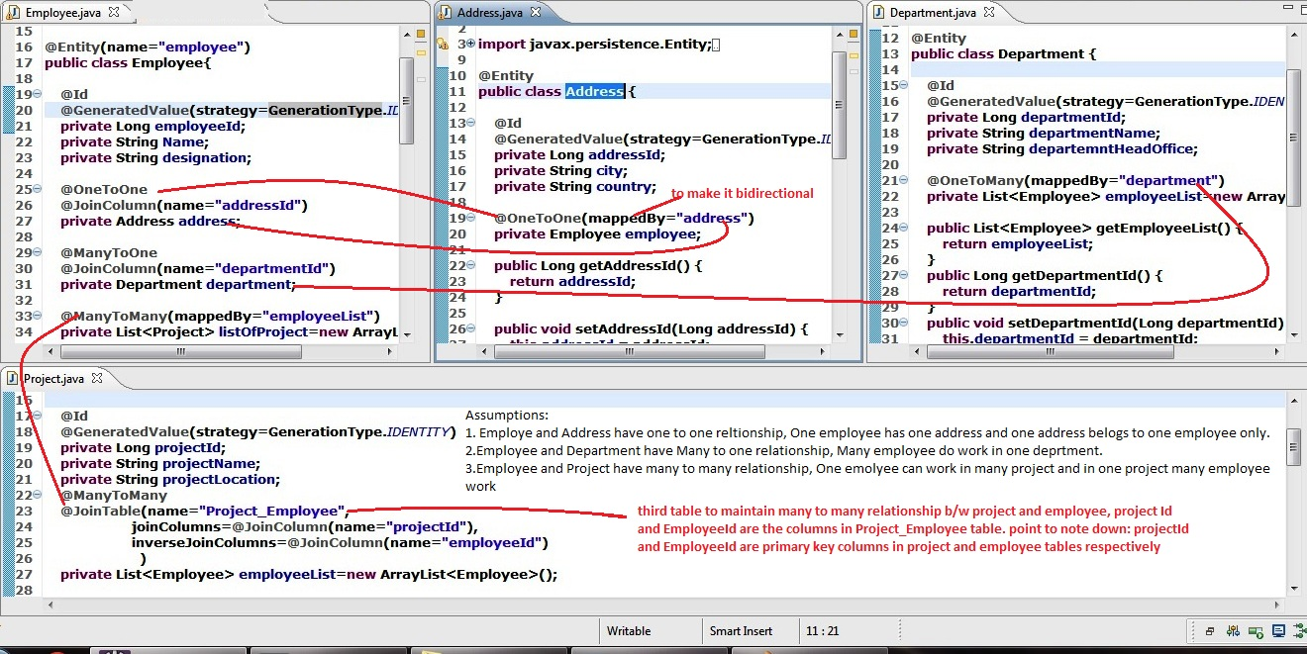
Entity : Relationship between entities : HAS-A

Slide 19
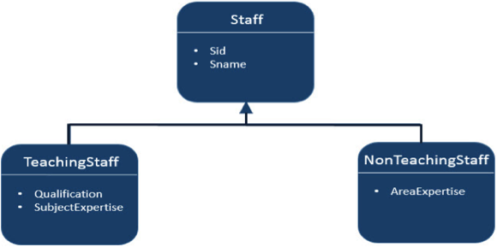
Entity : Relationship between entities
Inheritance (IS-A) between entities
JPA support three types of inheritance strategies such as
SINGLE_TABLE,
JOINED_TABLE,
TABLE_PER_CONCRETE_CLASS.
Inheritance strategy decides how entity data should be stored in database tables.
Let us consider an example of Staff, TeachingStaff, NonTeachingStaff classes and their relationships as follows:
In the above shown diagram Staff is an entity and TeachingStaff and NonTeachingStaff are the sub entities of Staff. Here we will discuss the above example in all three strategies of inheritance

Slide 20
Entity : Relationship between entities : Inheritance
Single Table strategy
Name of Discriminator Column : Type
Value of Discriminator Column : TS and NS for teaching staff and non-teaching staff respectively
Sid | Type | Sname | Areaexpertise | Qualification | Subjectexpertise
1 | TS | Gopal |  | MSC MED | Maths
2 | TS | Manisha |  | BSC BED | English
3 | NS | Satish | Accounts
4 | NS | Krishna | Office Admin

Slide 21
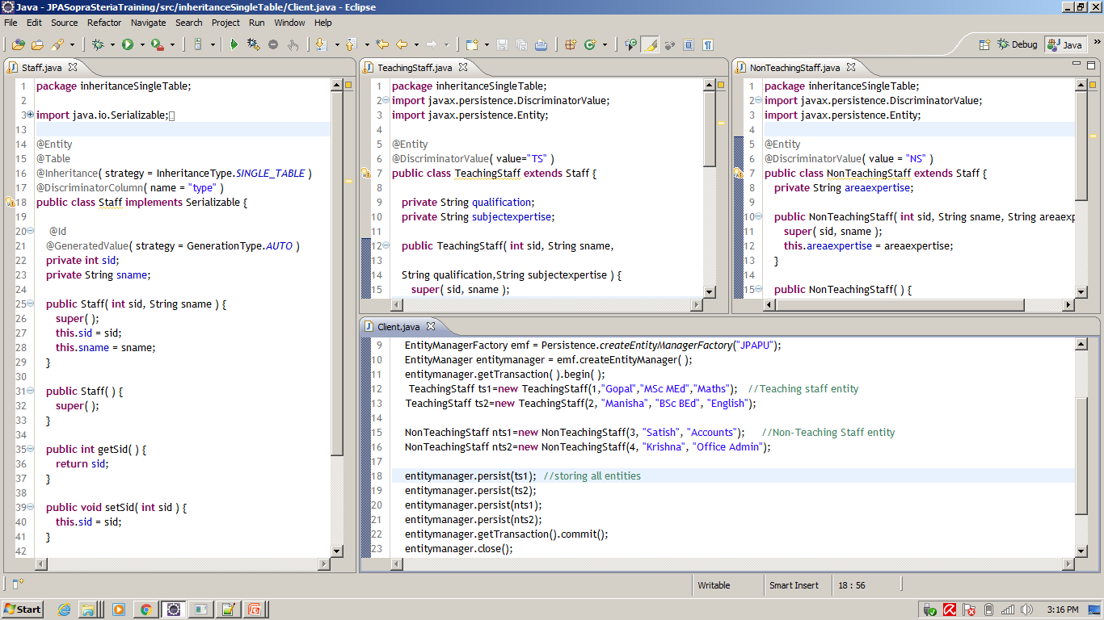
Entity : Relationship between entities : Inheritance
Single Table strategy

Slide 22
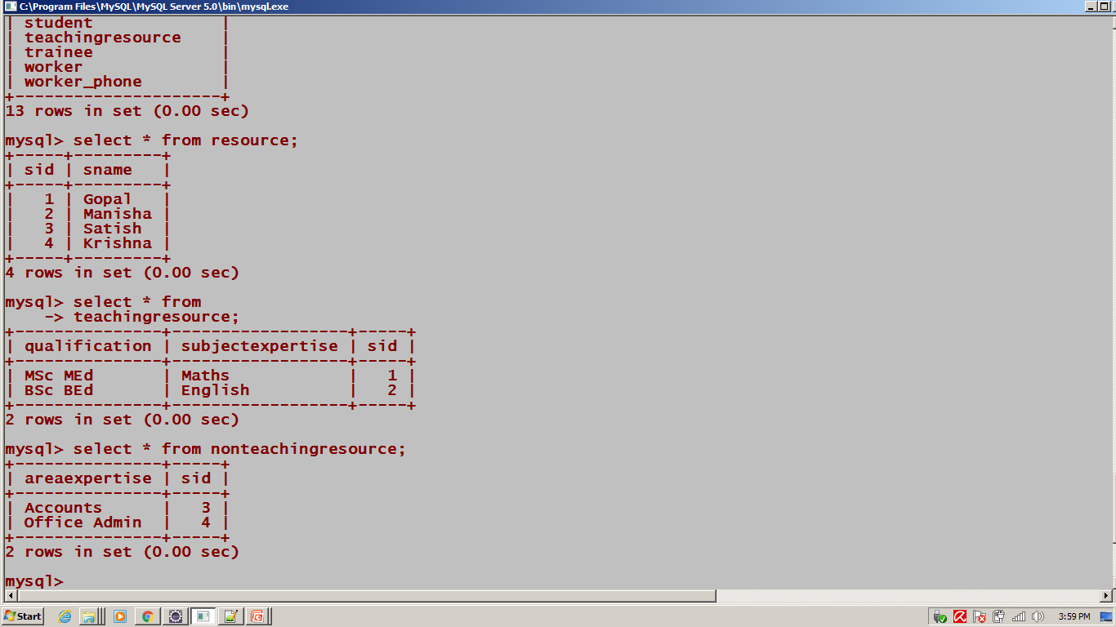
Entity : Relationship between entities : Inheritance
JOINED STRATEGY
Based on primary-Foreign key

Slide 23
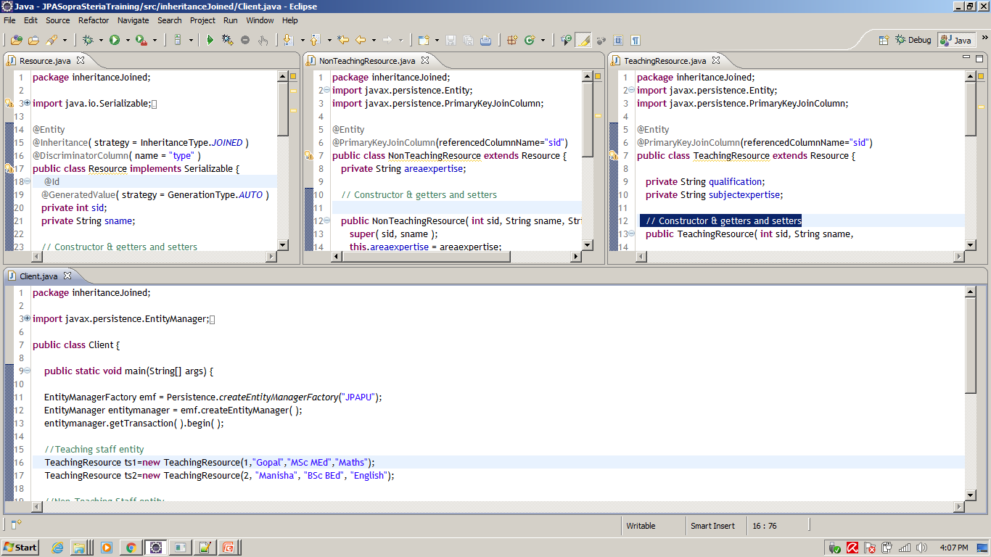
Entity : Relationship between entities : Inheritance
JOINED STRATEGY

Slide 24
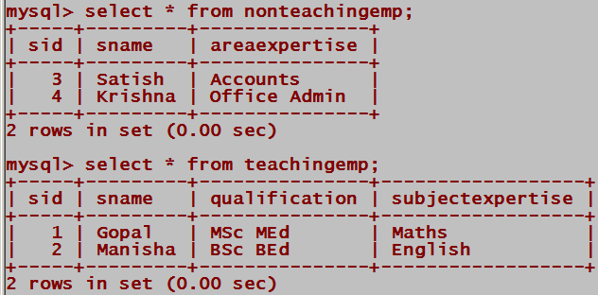
Entity : Relationship between entities : Inheritance
TABLE PER CLASS Strategy

Slide 25
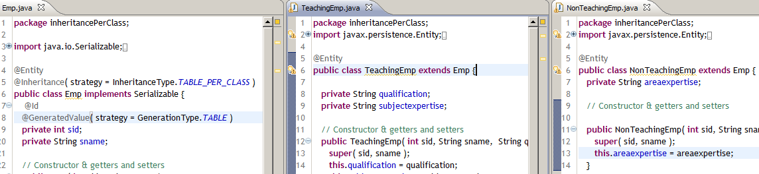
Entity : Relationship between entities : Inheritance
TABLE PER CLASS Strategy

Slide 26
Entity Manager & Persistence Context
EntityManager manges entities. The entity manager is represented by javax. persistence. Entity Manager instances Each EntityManager instance is associated with a persistence context
A persistence context defines the scope under which particular entity instances are created, persisted, and removed A persistence context is a set of managed entity instances that exist in a particular data store Entities keyed by their persistent identity Only one entity with a given persistent identity may exist in the persistence context Entities are added to the persistence context, but are not individually removable (“detached”) Controlled and managed by EntityManager Contents of persistence context change as a result of operations on EntityManager API

Slide 27
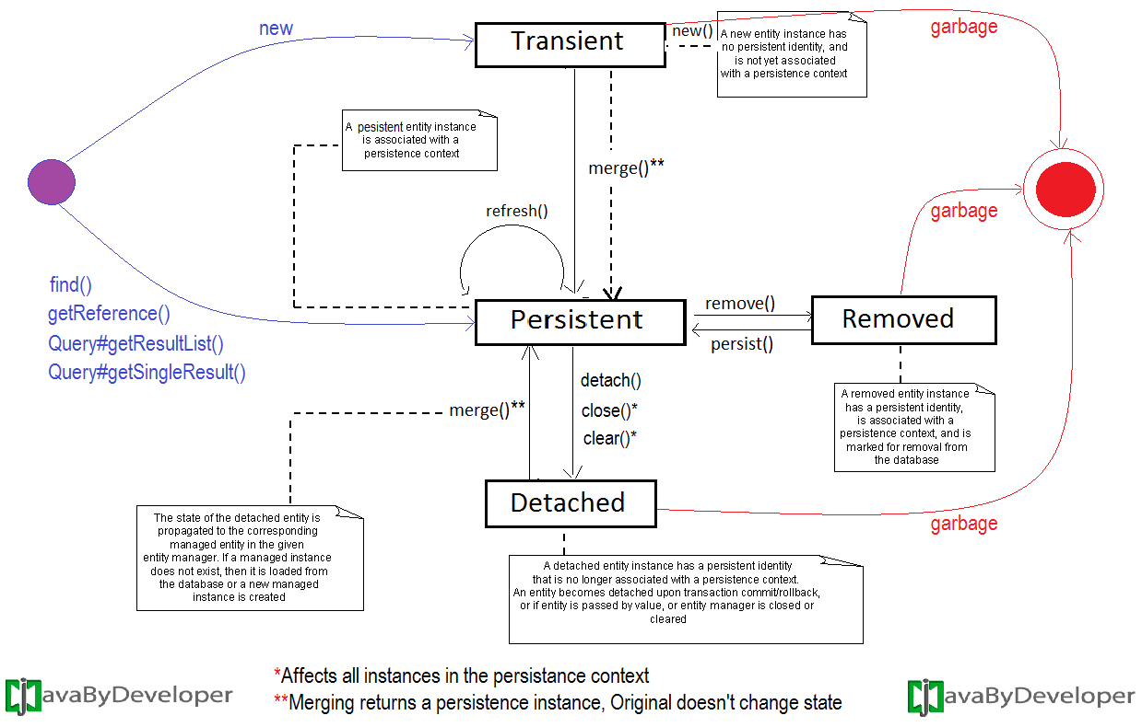
Entity Manager & Persistence Context & Entity Life cycle
Persistent Context

Slide 28
Entity Manager & Persistence Context & Entity Life cycle
Transient State :
A newly created object and object identifier should not be there in database.
Objects instantiated using the new operator are not immediately persistent. Their state is “Transient”. Which means they are not associated with any database table row, and so their state is lost as soon as they are reference removed. Transient state instances state is lost and garbage-collected as soon as they are no longer referenced.
Persistent (managed) State :
if the object is associated with persistence-context then that object state is “Persistence State” . Persistent(Managed) state instances are always associated with persistence-context and transnational.
If we are changing persistent State object values those are synchronized automatically with the database while committing the transaction.

Slide 29
Entity Manager & Persistence Context & Entity Life cycle
Detached State :
Object identifier should be there in database table and Object should not associated with persistence-context.
Instances loose their association with persistence context when you close() entity manager. We refer to these objects as detached.
Indicating that their state is no longer guaranteed to be synchronized with database, they are no longer inside persistence context if their references removed, then they are eligible for garbage collector.
Removed State :
A persistent state entity object can also be retrieved from database and marked for deletion, by using the EntityManger’s remove() with in an active transaction. Then entity object changes its state from Persistent to Removed, and physically deleted from the database during commit.

Slide 30
Types of EntityManager
Outside EJB Container means in Java SE application
AplicationManaged EntityManager:
created by Persistence→EntityManagerFactory-→EntityManager using name of PU
EntityManager manages transaction itself
Inside EJB Container like Weblogic/ Websphere/JBOSS means in Java EE application
AplicationManaged EntityManager
Injected using Persistent unit as below
@persistentUnit (name=“JPAPU”)
private EntityManager em;
can create transaction itself and manage the same
Container Managed EntityManager
A ) Transactionscoped
@PersistenceContext(type=PersistenceContextType.TRANSACTION)
private EntityManager em;
B ) Extendedscoped
@PersistenceContext(type=PersistenceContextType.EXTENDED)
private EntityManager em;

Slide 31
Types of EntityManager
Outside EJB Container means in Java SE application
AplicationManaged EntityManager:
created by Persistence→EntityManagerFactory-→EntityManager using name of PU
EntityManager manages transaction itself
Inside EJB Container like Weblogic/ Websphere/JBOSS means in Java EE application
AplicationManaged EntityManager
Injected using Persistent unit as below
@persistentUnit (name=“JPAPU”)
private EntityManager em;
can create transaction itself and manage the same
Container Managed EntityManager
A ) Transactionscoped
@PersistenceContext(type=PersistenceContextType.TRANSACTION)
private EntityManager em;
B ) Extendedscoped
@PersistenceContext(type=PersistenceContextType.EXTENDED)
private EntityManager em;

Slide 32
JPA Query Language (JPQL)
What is JPQL:
JPA has a query language based on SQL .JPQL is an extension of EJB QL
More robust flexible and object-oriented than SQL. The persistence engine parses the query string, transform the JPQL to the native SQL before executing it
Creating Queries
Query instances are obtained using:
EntityManager.createNamedQuery (static query)
EntityManager.createQuery (dynamic query)
EntityManager.createNativeQuery (native query)
Query API:
getResultList() – execute query returning multiple results
getSingleResult() – execute query returning single result
executeUpdate() – execute bulk update or delete
setFirstResult() – set the first result to retrieve
setMaxResults() – set the maximum number of results to retrieve
setParameter() – bind a value to a named or positional parameter
setHint() – apply a vendor-specific hint to the query
setFlushMode()– apply a flush mode to the query when it gets run

Slide 33
JPA Query Language (JPQL)
NamedQuery
Defined statically with the help of @NamedQuery annotation together with the entity class
@NamedQuery elements:
name - the name of the query that will be used with the createNamedQuery method
query – query string
@NamedQuery(name="findAllCustomers“,query="SELECT c FROM Customer")
OR
NamedQueries( {
@NamedQuery(name = “Mobile.selectAllQuery” query = “SELECT M FROM MOBILEENTITY”),
@NamedQuery(name = “Mobile.deleteAllQuery” query = “DELETE M FROM MOBILEENTITY”)
) }
Query findAllQuery = entityManager.createNamedQuery(“Mobile.selectAllQuery”);
List<Mobile> mobileList= findAllQuery.getResultList();

Slide 34
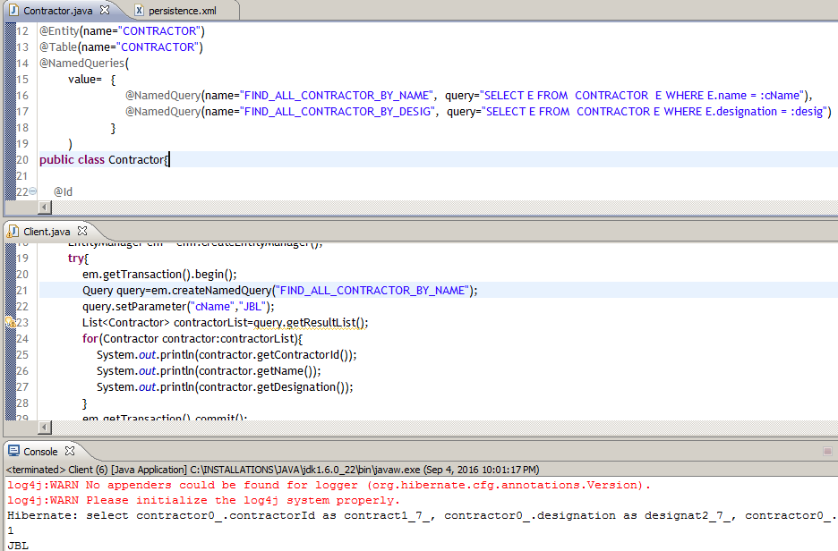
JPA Query Language (JPQL)

Slide 35

Questions
Notes:
Optional slide

Slide 36


